Slide 1
Admission process : Master’s – Eiffel Scholarship
Law, Computer Sciences, Administration and Communication, Information and Communication
Dear applicant,
Thank you for your interest in Eiffel Scholarship ! Please find below some key information regarding this campaign.
Our service compiled this document to guide you through your application process. We strongly advise you to read it in its entirety before reaching out: we receive a lot of e-mails when campaigns are open, and although we do our best to answer your enquiries quickly, it might take a while for us to get back to you. Hopefully you will find there all the answers to your questions !
Here is what you will find in these guidelines:
Page 2: Information regarding the Eiffel Scholarship + Results dates
Page 3: How and where to apply to Eiffel
Page 4: Creating your account on eCandidatures
Page 5: Documents needed for one application
Page 6: Filling in the extra form
Page 7: Sending your application + What happens next?
Page 8: eCandidatures technical FAQ
The eCandidatures platform for Law, Computer Sciences, Administration and Communication, Information and Communication
as the Eiffel scholarship is concerned
will be accessible from Octoberber 24th up until November 17th, 2024.
Before that, you will only be able to create your account and fill in your information.
We strongly encourage you to avoid applying at the last minute in case your application would be deemed incomplete.
The International Office will not accept any application which would have been sent after November 17th, 2024, 11:59 pm.

Slide 2
Specificities of the Eiffel scholarship + Results dates
Make sure you visit our webpage and go through the program rules before applying: you will there find all necessary information regarding the benefits of the Eiffel scholarship as well as the conditions to apply.
Eligible candidates must fit the following criteria:
Admission results:
The admission and Eiffel selection results will be available by April, 2025.
Results of the Eiffel scholarship attributions are expected early April. We will let you know as soon as we hear back from Campus France.
Born after March 31st, 1997;
Foreign nationals only: if you hold a French citizenship, your application cannot be selected for the scholarship;
New to the French education system: students currently studying or who studied in France are no longer eligible;
Excellent academic results.
We can only support your application for the Eiffel scholarship, but this is the only part we have in the process. We then send the applications we selected to Campus France, where they will be reviewed by a national selection committee.

Slide 3
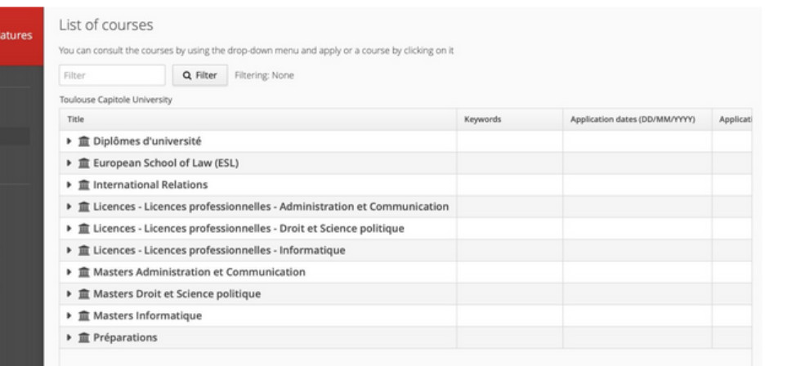
How and where to apply
Apply to UT Capitole via our eCandidatures platform :
https://v2-ecandidatures-ut1.ut-capitole.fr/ecandidat-V2/#!accueilView
r :
You select «International Relations»
Find your diploma and finalise your application
This application procedure is detailed in the next pages.
Start by creating your account, then click on the link you received to confirm your e-mail address (link valid for a limited time).

Slide 4
Creating your account on eCandidatures
Before being able to work on your application, you must fill in your information
by clicking on the different items showing in the column on the left.
Here are some instructions to help you.
Note that you can change the language in the home screen (“accueil”).
4) External course
Indicate all the studies you followed after secondary school (Bachelor’s and/or Master’s).
Choose “Licence” for a Bachelor’s degree and “Master” for a Master’s degree.
Specify the title of your degree in “Course description”
1) Personal Info.
Leave the INE section empty
(only former students of the French education system have it).
5) On-the-job training
Recommended but optional section. Refer any internship or trainee positions you may have had.
2) Baccalauréat (Name of the secondary school diploma degree in France)
Tick “I have the baccalauréat or equivalent qualification”
Then “0031 – titre étranger admis en equivalence” (equivalent foreign diploma).
To specify your grade: Très Bien is A+, Bien is A, Assez bien is B, and Passable is C.
6) Professional experience
Recommended but optional section. Refer any jobs you may have had.
3) Internal curriculum
Leave the section empty
Your account is ready!
You can now click on “Applications” to select the Master’s program of your choice.

Slide 5
Documents needed for one application
Please submit a file for each line of your application. Check our FAQ section for some additional tips regarding size of documents or frequent technical problems
1) Copy of your passport or national ID card
6) Certificate of language proficiency
2) Résumé
in English for an International track;
in French for a Standard track.
3) Cover letter
in English for an International track;
in French for a Standard track.
Specify why you chose UT Capitole but also why you need and deserve the Eiffel scholarship, how it would make a difference to you.
7) Letters of recommendation
4) Copy of all your transcripts (undergraduate and postgraduate grades when available),
translated into English or French if needed.
Official translation required. Combined in a single file.
5) 2nd year application only, if available by the time of your application: proof or copy of your
Bachelor’s degree and/or Master’s degree
translated into English or French if needed.
Official translation required. Combined in a single file.

Slide 6
Filling in the extra form
Technical tips:
Make sure you’re still connected to eCandidatures while you fill it in.
Please note that your answers will only be visible the next day as the system updates every night.
Once you fill it in, your answers will be visible in each of your different applications.
We would thus advise you to do one application first, to fill in the questionnaire, and then come back the next day to deal with your other applications. That way you can check in the tab that your answers were taken into account.

Slide 7
Sending your application + What happens next?
Send your application by clicking on
3 possible answers
available on eCandidatures
by December 2nd (check your e-mails!)
You will receive a confirmation e-mail.
Once the file is sent, you cannot modify it so make sure
everything is finalised before sending it.
1) The International Office declines your application.
The International office will review your documents.
Check your e-mails regularly!
2)The International Office approves your application BUT does not support your Eiffel scholarship application.
You are welcome to enroll in September 2025 and look for other scholarships to finance your studies in France.
If your file is NOT complete, please rectify the missing documents by the return deadline
(Nov. 17th 24).
Incomplete files will not be reviewed by our selection committee.
If your file is complete, the selection commitee will review your application.
You will then receive one of three possible answers.
3) The International Office approves your application AND supports your Eiffel scholarship application.
The International Office will be in touch shortly so we can build your file and send it to Campus France!
Confirm the offer by April 8th, 2025. Enrollment will take place at your arrival at UTCapitole in September.
The International Office will get in touch to prepare your arrival!
You decline the offer by April 8th, 2025.
Re-send your application

Slide 8
eCandidatures technical FAQ
“I cannot log in, the website shows a message of error Erreur à la validation du compte.”
Depending on your browser or e-mail provider, the link you receive in the automated e-mail to validate your account may not work.
You have to close eCandidatures (if already open), then copy the URL address and paste it in your browser. Do not hesitate to try a different browser.
“I cannot upload my documents because they are too big.”
Indeed you need to upload a single PDF file (or JPEG/PNG format) that cannot exceed 2 MB.
To merge or compress your documents, you can use free online tools provided by websites such as PDF2GO or IlovePDF.
“I cannot modify anything in my application file because it is “blocked by another user”.”
You must have opened eCandidatures in several pages or different browsers (or closed the page and reopened it right away).
You need to log out, close everything, and open eCandidatures again after having waited for a couple of minutes.
If you could not find the answer to your question here, do not hesitate to get in touch with the International Office
by writing to Eiffel@ut-capitole.fr.

