Slide 1
Migration Challenges
Council of the European Union
General Secretariat
Directorate-General D - Justice and Home Affairs
Home Affairs
1B External Relations, Asylum and Migration Unit
Susanne Nielsen
Political Administrator
2019

Slide 2
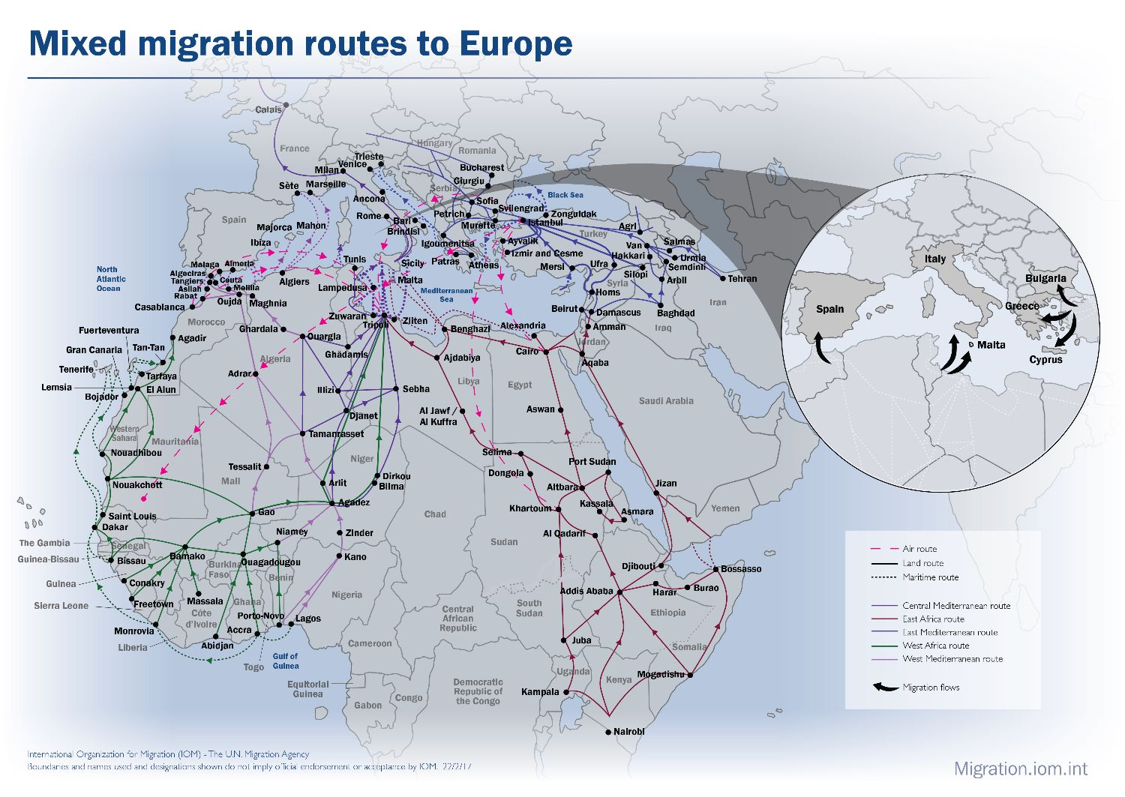
Mixed migration routes to Europe

Slide 3
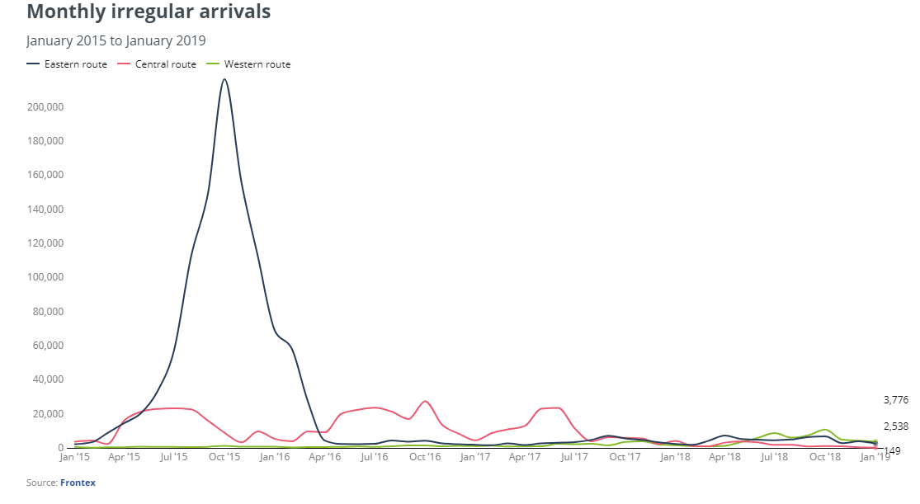
Migration flows:
Western, Eastern and Central Mediterranean routes
Frontex, February 2019

Slide 4
Irregular Arrivals: Top Nationalities
January 2018 – January 2019
Frontex, February 2019

Slide 5
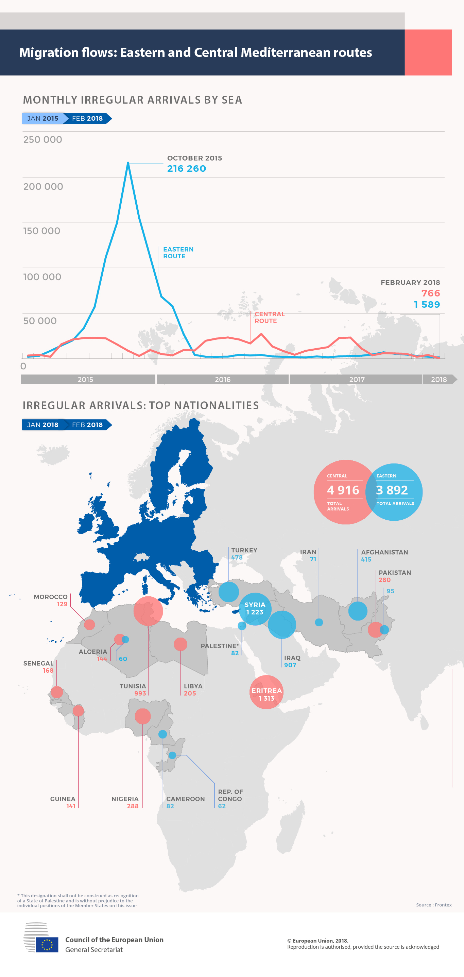
Emergency Response Coordination Centre (ERCC)
Migration and Refugee Crisis – Mediterranean routes
IPCR, 26 February 2019

Slide 6
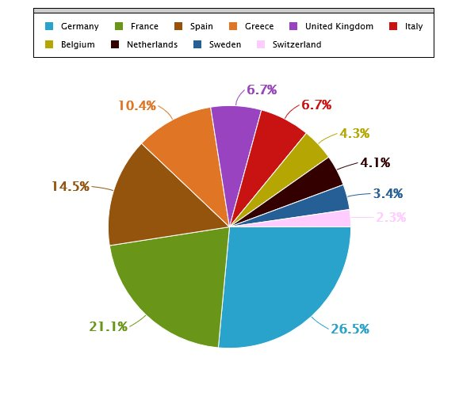
Total Asylum applications until 24 February (top 10 countries - 2019)
Source: ISAA report 153

Slide 7
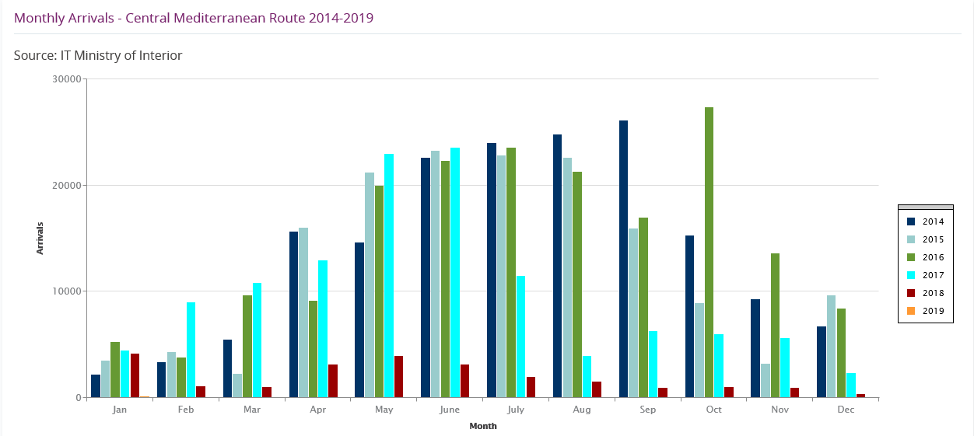
Migration flows: Central Mediterranean route
IT Ministry of Interior, February 2019
Notes:
Choose btw table or fancy infographic

Slide 8
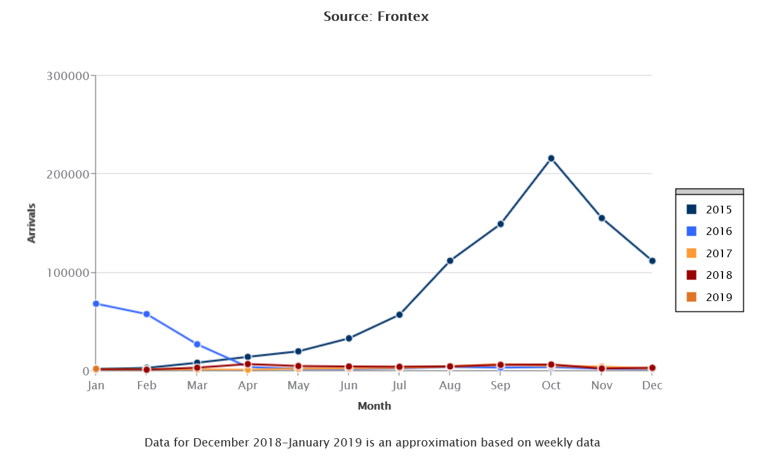

Slide 9
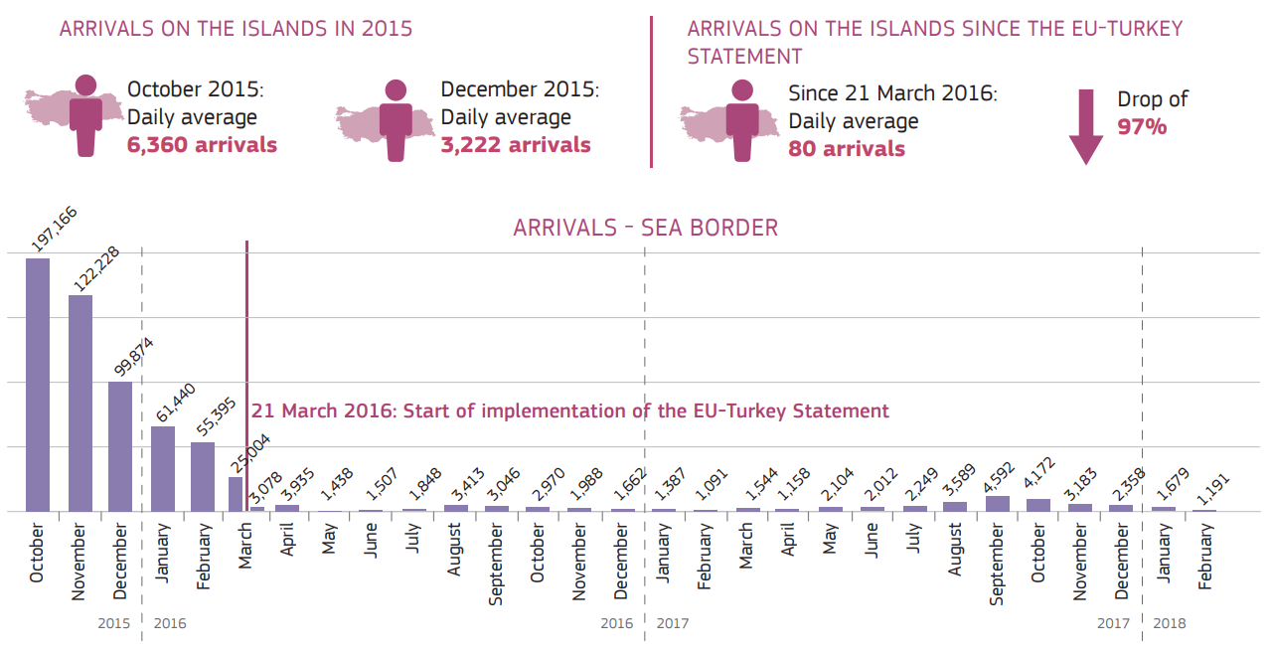
EU Turkey Statement - two years on
European Commission, April 2018

Slide 10
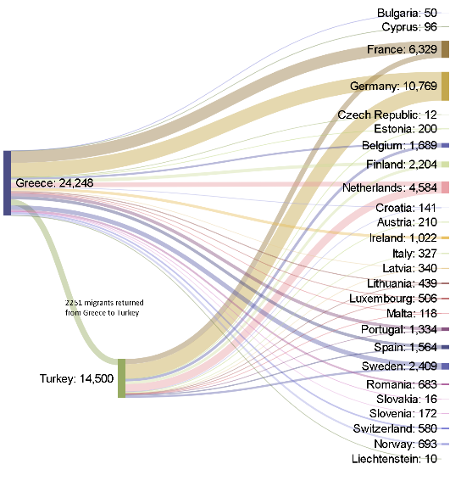
RELOCATION and RESETTLEMENT from Greece and Turkey
IPCR, 28 June 2018
1 March 2019

Slide 11
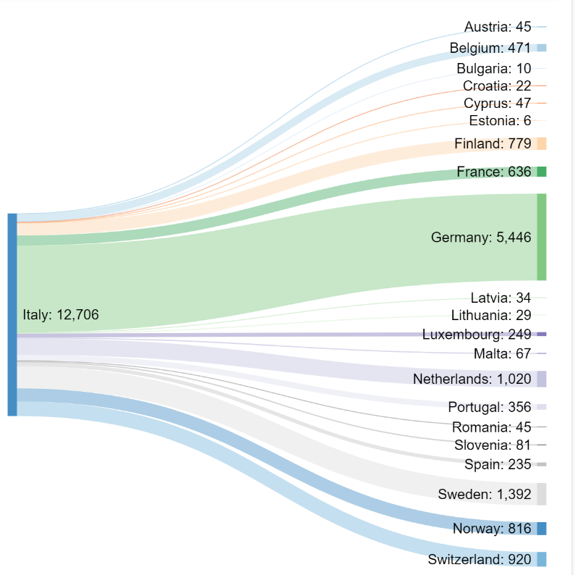
RELOCATION from Italy
IPCR, 30 October 2018

Slide 12
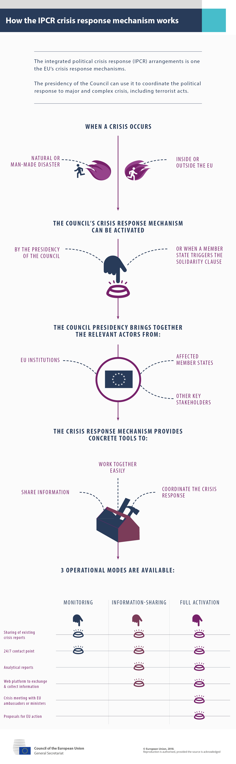
How the IPCR crisis response mechanism works
Notes:
The integrated political crisis response arrangement is one of the EU’s crisis response mechanisms.
The presidency of the Council can use it to coordinate the political response to major and complex crisis, including terrorist acts

Slide 13
EU Agencies supporting Member States in the area of Asylum and Migration
FRONTEX – The European Border and Coast Guard Agency facilitates and improves the application of existing and future EU measures relating to the management of external borders in line with the EU fundamental rights charter and the concept of Integrated Border Management.
EASO - The European Asylum Support Office assists Member States in fulfilling their European and international obligations in the field of asylum.
EUROPOL - The European Police Office assists Member States’ police forces in improving their cooperation on the prevention and fight against the most serious forms of international crime, such as terrorism, drug trafficking and people smuggling, focusing on the targeting of criminal organisations.

Slide 14
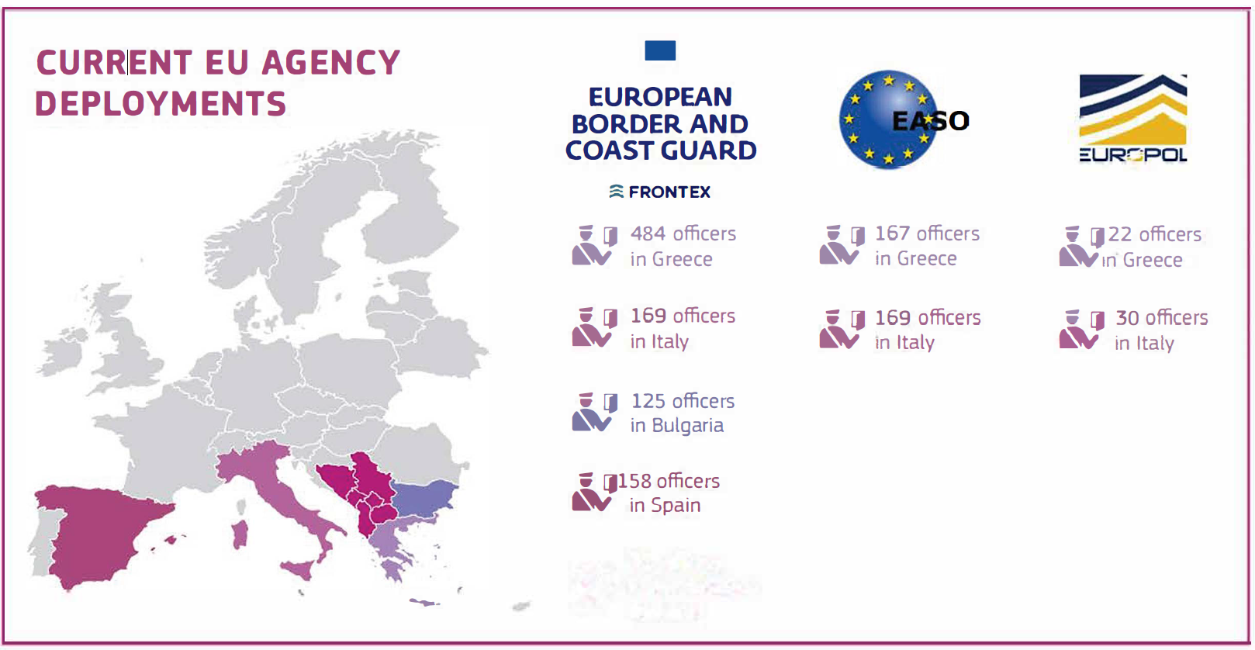
EU Agencies supporting Member States in the area of Asylum and Migration
Source: IPCR
(as of 24 February 2019)
Notes:
Alternatively

Slide 15
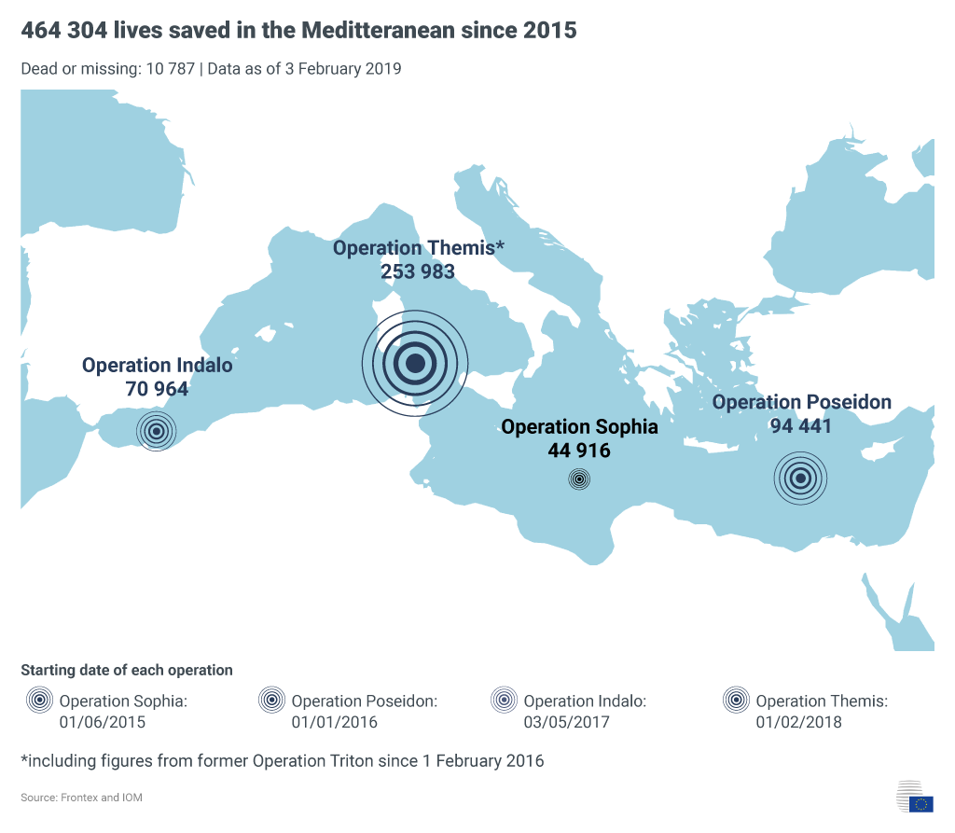

EU Mediterranean operations: over 464 304 lives saved since 2015

Slide 16
Reform of the Common European Asylum System (CEAS)
EU Treaties objective: a uniform asylum status valid throughout the Union
6 April 2016, Commission Communication:
“Towards a reform of the Common European Asylum System and enhancing legal avenues to Europe”
uneven implementation of the CEAS → incentive for asylum-seekers to apply for asylum in those member states where it is most likely to be granted
4 May 2016, 1st package of proposals for reform of the CEAS:
  Proposal for a Regulation to reform the Dublin system
  Proposal for a Regulation to amend EURODAC
  Proposal for a Regulation to establish an EU Agency for Asylum
13 July 2016, 2nd package of proposals for the reform of the CEAS:
  A new Regulation to replace the Asylum Procedures Directive
  A new Regulation to replace the Qualification Directive
  Targeted modifications of the Reception Conditions Directive

Slide 17
Thank you for your attention!
Susanne Nielsen
Political Administrator
susanne.nielsen@consilium.europa.eu
General Secretariat of the Council of the EU
DG D - Justice and Home Affairs
Home Affairs
1B External Relations, Asylum and Migration Unit

