Slide 1
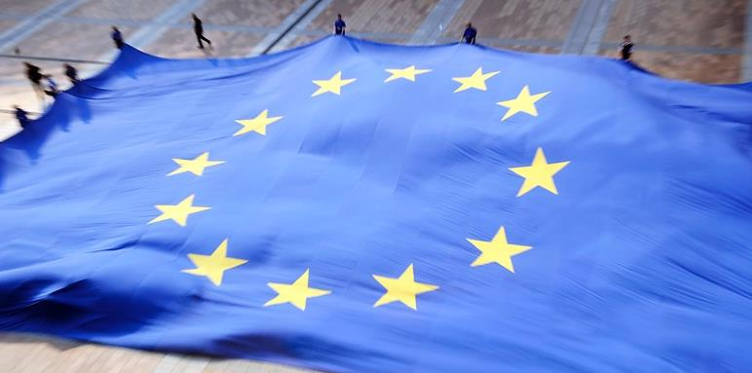
The European Parliament
Notes:
The European Parliament – the democratic heart of Europe:
Represents the people of Europe
Young (modern) and open institution
Stands for democratic power and influence

Slide 2
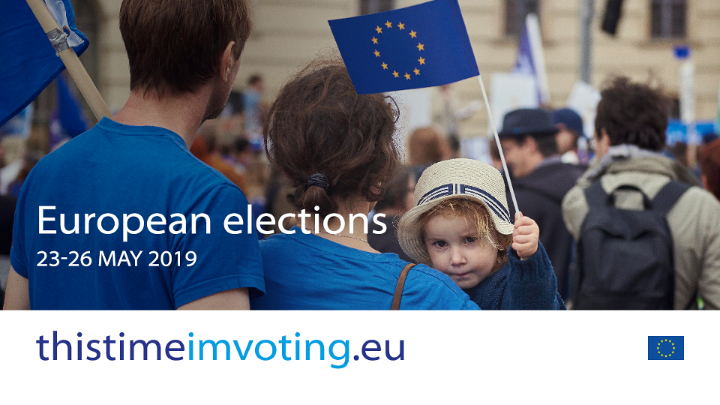
Notes:
European Parliamentary elections, 23-26 May 2019:
The European Parliament is the democratic arm of the European Union and as such, it cannot afford to take democracy for granted; it has to take a stand to protect it. Voting is the quintessential democratic act that every adult European has the right to partake in. And the more people vote, the stronger and the more legitimate European democracy becomes.
The European Parliament has successfully served as an entity that empowers and protects people – only through democratic engagement can Parliament carry on its work
But European elections are also important for the EU in other ways too. The European Union is constantly evolving, and the 2019 elections represent the moment when citizens can choose their future and pronounce themselves on where they want the EU to head. The very future of Europe will thus be shaped by outcome of the European elections in many ways.
thistimeimvoting.eu
This is why the European Parliament is launching a call for volunteers on thistimeimvoting.eu. Because this time, it isn’t simply about raising awareness about the EU and its importance. It’s about attesting the importance of engaging in the democratic process as a way to safeguard its very existence and to empower people
We are not here to advocate who people should vote for: we are here to advocate for the importance of the act of voting itself, the act of engaging in the democratic process.
When everybody votes, everybody wins.
Links:
Infrographic EPRS: 2019 European elections: National rules
http://www.europarl.europa.eu/RegData/etudes/ATAG/2018/623556/EPRS_ATA(2018)623556_EN.pdf

Slide 3
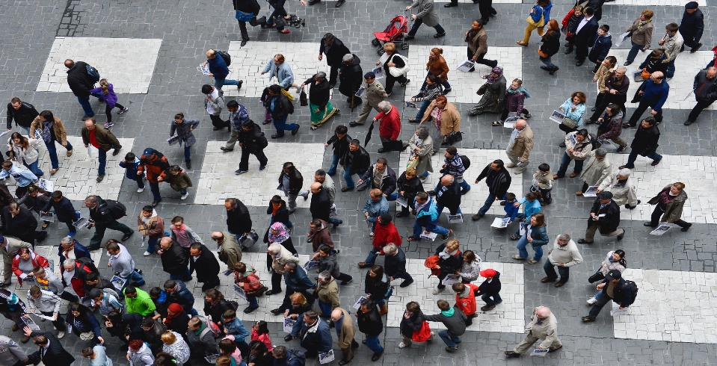
We are the people of Europe
Notes:
United in diversity
We are different, but we have so much in common. Our motto tells it all: “United in diversity.” It signifies how Europeans have come together, in the form of the EU, to work for peace and prosperity, to find common solutions to common problems, while at the same time being enriched by the continent's many different cultures, traditions and languages. It is our core strength and we are proud of it.
Link:
Find the EU’s motto in your own language:
https://europa.eu/european-union/about-eu/symbols/motto_en

Slide 4
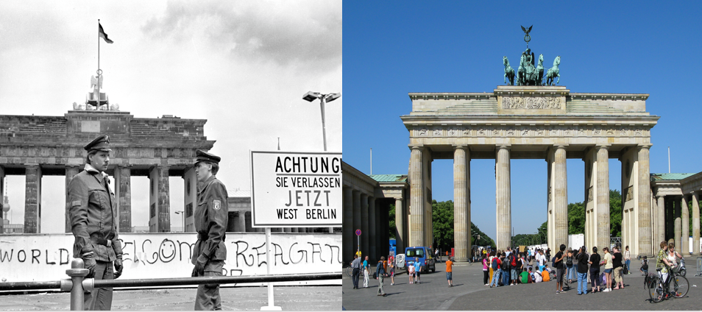
Then and Now – the origins of EU
Notes:
The origins of EU
To know where we go we must know where we come from.
Europe, risen from the ashes after 1945 and united in 1989, has a great capacity to reinvent itself and we can be proud of that too. But every generation has to give its own share.
The European project was created to reconcile old enemies and provide a structure to prevent future conflicts
60 years of peace between EU member states is the longest ever on this continent, ravaged by war and conflicts.
We are all laureates of the Nobel Peace Prize, received by the EU in 2012. The Norwegian Nobel Committee said its decision was based on the stabilising role the EU has played in transforming most of Europe from a continent of war to a continent of peace.
The European Union has become our common house, the “homeland of our homelands” as described by Vaclav Havel.
Jean Monnet: «Mieux vaut se disputer autour d’une table que sur un champ de bataille.» (“Better to fight around a table than on a battle-field”)
Winston Churchill – https://multimedia.europarl.europa.eu/en/united-states-of-europe-winston-churchill_B001-0099_ev
Links
Brief history of the EU (Signing of Rome Treaties)
https://multimedia.europarl.europa.eu/en/history-the-treaties-of-rome_V001-0011_ev

Slide 5
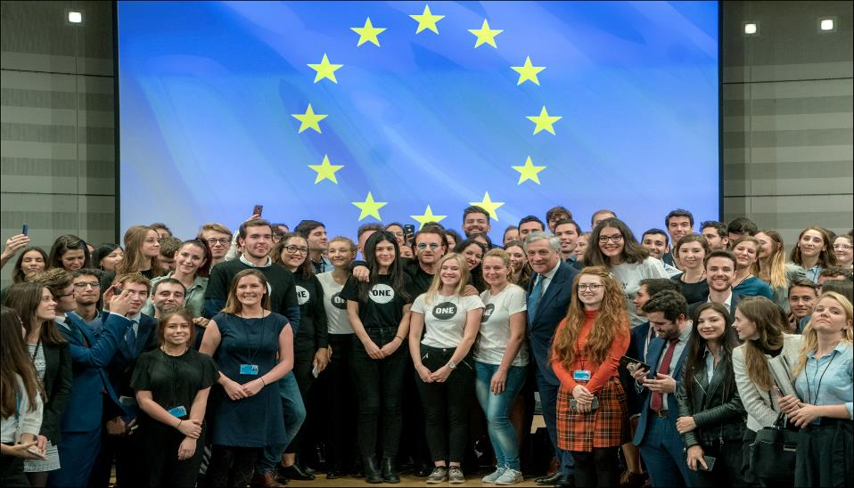
Europe is a thought that needs to become a feeling
Notes:
Changing time, same values
The EU is a community of values, not only an internal market of 500 million consumers.
It is founded on the values of respect for human dignity, freedom, democracy, equality, the rule of law and respect for human rights, including the rights of minorities.
Fundamental rights apply to all people in the EU, no matter their status or origin. Some of these freedoms are as old as Europe: life and liberty, thought and expression. But others have had to be redefined to keep pace with the times. Protecting personal data or prohibiting human cloning were far from the minds of the first elected MEPs, some four decades ago.
After more than 60 years we still champion the same values: EuroBarometer surveys show that human rights always rank the highest when Europeans are asked.
The Parliament defends democracy and the rule of law at the European level.
Link:
Rule of law Art. 7: http://www.europarl.europa.eu/news/en/headlines/eu-affairs/20180222STO98434/rule-of-law-concerns-how-the-eu-can-act-infographic
EuroBarometer survey on citizens opinion of EU – http://ec.europa.eu/commfrontoffice/publicopinion/index.cfm/ResultDoc/download/DocumentKy/84930

Slide 6
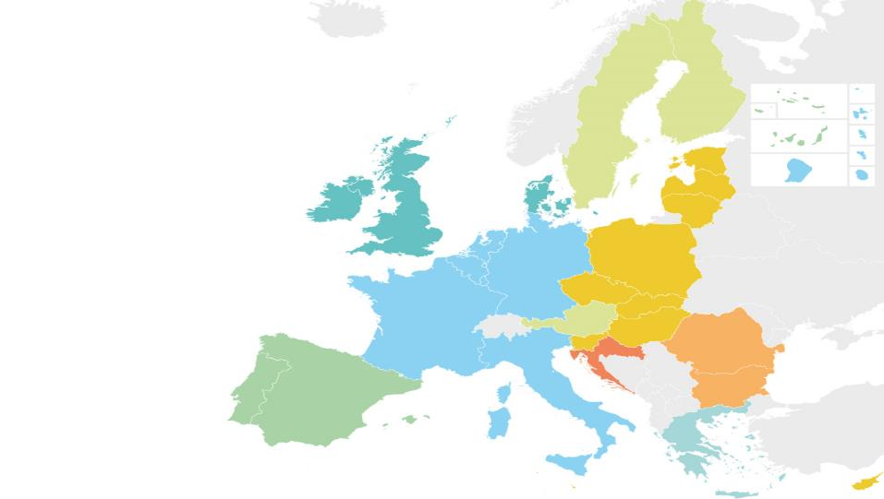
European Union family
Suomi
Finland
Sverige
Eesti
1952
1973
1981
1986
1995
2004
2007
2013
Latvija
Éire
Ireland
Danmark
Lietuva
United Kingdom
Nederland
België/Belgique/Belgien
Deutschland
Polska
Luxembourg
Česká
republika
Slovensko
France
Österreich
Magyarország
Slovenija
Hrvatska
România
Italia
България
Bulgaria
Portugal
España
Ελλάδα
Elláda
As of November 2018
Κύπρος
Kypros
Kıbrıs
Malta
Notes:
The European Union family
The EU is changing. The family has grown a lot in the past decades: there were 8 waves of enlargement, from 6 Member States to 28 Member States.
5 official candidate countries: Albania, Northern Macedonia, Montenegro, Serbia and Turkey (EP has called for the halt of EU negotiations).
Potential candidates: Bosnia and Herzegovina and Kosovo
When is a country ready? The Copenhagen criteria:
- political criteria: stability of institutions guaranteeing democracy, the rule of law, human rights and respect for and protection of minorities;
- economic criteria: a functioning market economy and the capacity to cope with competition and market forces;
- administrative and institutional capacity to effectively implement the acquis and ability to take on the obligations of membership.
Special EU relations (friends/family members) - Iceland, Norway and Liechtenstein participate directly in the single market via the European Economic Area. Switzerland does so via 120 bilateral agreements.
In June 2016, the UK voted in a referendum to leave the European Union
Link:
Conditions of EU membership:
https://ec.europa.eu/neighbourhood-enlargement/policy/conditions-membership_en
Expansions:
2013 - https://multimedia.europarl.europa.eu/en/croatia-joins-the-eu_B001-0135_ev
2007 - https://multimedia.europarl.europa.eu/en/the-eu-grows-to-27-member-states_B001-0130_ev
2004 – https://multimedia.europarl.europa.eu/en/the-eu-expands-to-the-east_B001-0128_ev
1995 – https://multimedia.europarl.europa.eu/en/austria-finland-and-sweden-join-the-eu_B001-0124_ev
1986 – https://multimedia.europarl.europa.eu/en/history-the-mediterranean-enlargement-19811986_V001-0014_ev
1981 – https://multimedia.europarl.europa.eu/en/greece-becomes-the-10th-member-state-of-the-european-communities_B001-0108_ev
1973 - https://multimedia.europarl.europa.eu/en/first-eu-enlargement_B001-0104_ev

Slide 7
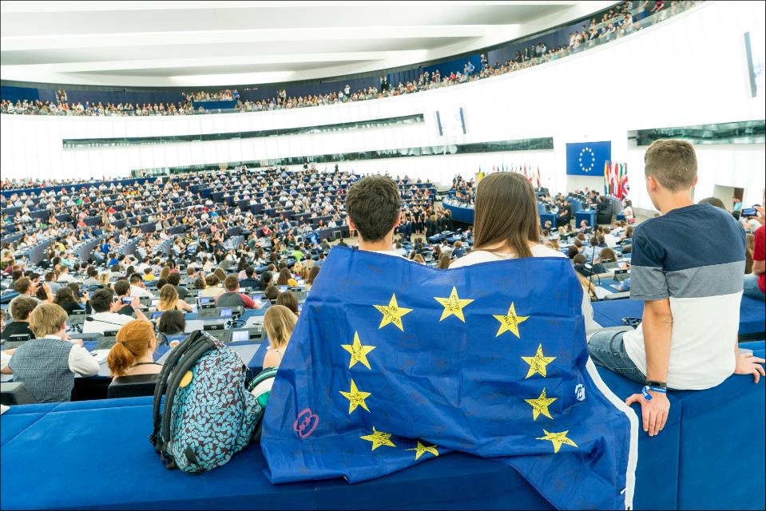
What makes the European Parliament unique
Notes:
What makes the European Parliament unique
The only directly elected EU institution - members are elected by us - EU citizens.
The biggest transnational parliament of the world.
Diverse to a degree unknown elsewhere in the world - 751 MEPs represent more than 200 different national political parties from 28 countries.
Open transparent house - you can visit us or follow plenary and committee meetings from your home in your own language.
Multilingual - there is no discrimination between the official 24 languages, this is part of our identity.
Unlike any national parliaments. There is no government or opposition, compromise is key here, political groups in hemicycle form ad-hoc coalitions, there is an exciting dynamics based on national and party politics.
Work in Strasbourg, Brussels and Luxembourg, but has liaison offices in 28 countries.

Slide 8
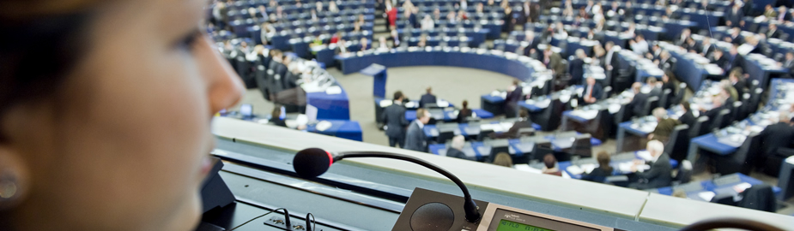
24 official languages, 552 language combinations and sign languages
bg | български | fr | français | nl | nederlands
es | español | ga | gaeilge | pl | polski
cs | čeština | hr | hrvatski | pt | português
da | dansk | it | italiano | ro | română
de | deutsch | lv | latviešu | sk | slovenčina
et | eesti keel | lt | lietuvių | sl | slovenščina
el | ελληνικά | hu | magyar | fi | suomi
en | english | mt | malti | sv | svenska
Notes:
EU languages
Multilingualism is guaranteed by the treaties, it is part of the European heritage – and a democratic pre-requisite.
A world record (multiply 23x24 = 552 language combinations possible), The European Parliament has one of the largest interpreting services in the world.
Plus sign language as needed.
No one speaks 24 languages - interpretation is mostly done by using relay languages (EN, FR, DE). For example, from Hungarian to English, from English to Latvian.
MEPs have the right to speak in any of the official EU languages. MEPs tend to speak in their mother tongue (very appreciated by interpreters) in plenary sessions, while in negotiations or committee meetings they may use one of the more common languages – but only if they wish!
English is likely to remain an official EU language as unanimous agreement between EU leaders is needed to change the current set-up,
Link:
Legal aspects of EU multilingualism:
http://www.europarl.europa.eu/RegData/etudes/BRIE/2017/595914/EPRS_BRI(2017)595914_EN.pdf
EP and multilingualism
http://www.europarl.europa.eu/about-parliament/en/organisation-and-rules/multilingualism

Slide 9
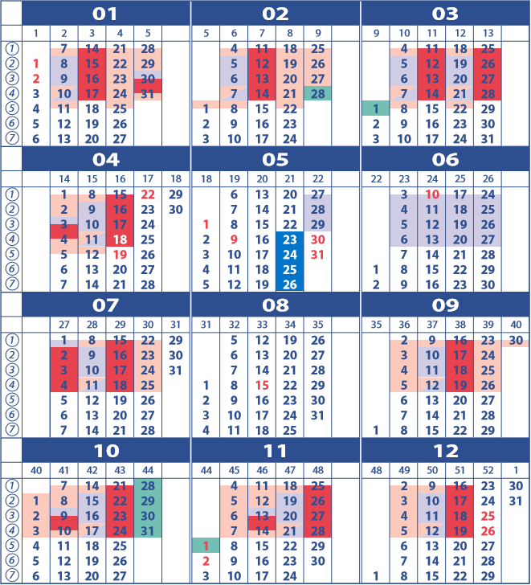
Working calendar
2019
Elections
Plenary meetings
Committee meetings
Political group meetings
External activity
Notes:
Working calendar
Every week of the month is different – EP works on the basis of a colourful calendar.
It is adopted at least one year in advance, the last plenary before elections will be held in April 2019, the new Parliament will first congregate in July 2019.
Pink weeks - committee week: where MEPs do the nitty-gritty of law-making by analyzing and amending Commission proposals and Council positions. (Maximum 16 meetings at the same time because of limited interpretation resources).
Blue weeks - political groups weeks: very political, preparing position of the political groups for the plenary.
Green weeks - external activity: MEPS are in their constituencies or on official delegations to countries or regions round the world.
Strasbourg/Brussels
The official seat of the EP is in Strasbourg, as agreed at the Edinburgh summit of EU leaders in 1992, and confirmed by a protocol of the Treaty of Amsterdam in 1999, unanimously agreed by all EU governments.
It’s a legal obligation to have 12 plenary sessions per year in Strasbourg.
In Brussels, committee meetings, political group meetings and additional plenary sessions are held.
This set up has historic and legal reasons - official EP seat foreseen in the treaty (unanimous vote required within the European Council for a treaty change).
Strasbourg is historically symbolic, having changed hands numerous times between France and Germany as a result of war – nowadays, we go there to find common solutions to common problems.
Links
Why was Strasbourg designated the official seat of the European Parliament
http://www.europarl.europa.eu/news/en/faq/20/why-was-strasbourg-designated-the-official-seat-of-the-european-parliament
European Parliament resolution of 20 November 2013 on the location of the seats of the European Union’s Institutions (2012/2308(INI))
https://eur-lex.europa.eu/legal-content/EN/TXT/?uri=uriserv:OJ.C_.2016.436.01.0002.01.ENG&toc=OJ:C:2016:436:FULL
ECJ opinion French Republic V European Parliament- Sept 2012
http://curia.europa.eu/juris/document/document.jsf?text=&docid=126385&pageIndex=0&doclang=EN&mode=lst&dir=&occ=first&part=1&cid=762012

Slide 10
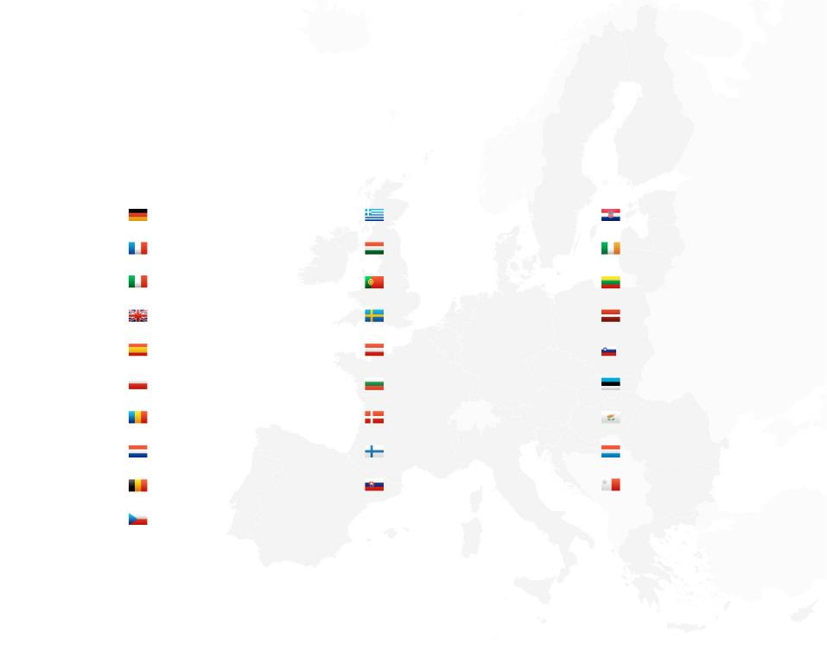
751 Members
96
Germany
21
Greece
11
Croatia
74
France
21
Hungary
11
Ireland
73
21
Portugal
11
Lithuania
Italy
8
73
United Kingdom
20
Sweden
Latvia
54
Spain
18
Austria
8
Slovenia
51
Poland
17
Bulgaria
6
Estonia
6
32
Romania
13
Cyprus
Denmark
6
26
Netherlands
13
Finland
Luxemburg
6
21
13
Slovakia
Malta
Belgium
21
Czech Republic
As of March 1, 2019
Notes:
751 Members
The European Parliament is made up of 751 Members elected in the 28 Member States of the European Union. Since 1979 MEPs have been elected by direct universal suffrage for a five-year period.
Seats are allocated on the basis of population of each Member State. Treaty limitations: maximum 751 Members, maximum 96/country, minimum 6/country.
Six is the minimum to ensure that the full range of political opinion in smaller countries is represented
According to the d’Hondt method used, less populous states are over-represented. There are several reasons for this:
EU member states share or pool sovereignty – giving proportionally more MEPs to smaller countries ensures that their voice is heard.
a strictly proportional (to smaller countries’ ratios) system would run in practical problems in terms of accommodating the large number of MEPs.
37%, slightly more than a third of MEPs, are women.
MEPs are grouped by political affinity, not nationality.
After the UK leaves the EU, the number of seats will be reduced to 705. 27 of the UK's 73 seats will be redistributed to other countries, while the remaining 46 seats will be kept for future enlargements.
In the current legislature, the youngest MEP was 26 when elected, while the oldest was 92.
MEPs come from all walks of life and all socio-economic classes.
Links
MEPs
http://www.europarl.europa.eu/meps/en/home
What is an MEP - video suited for a younger audience
https://www.youtube.com/watch?v=6wD4DdK7-rk
EU elections: how many MEPs will each country get in 2019?
http://www.europarl.europa.eu/news/en/headlines/eu-affairs/20180126STO94114/eu-elections-how-many-meps-will-each-country-get-in-2019
EPRS At a Glance - Composition of the European Parliament
http://www.europarl.europa.eu/RegData/etudes/ATAG/2018/623533/EPRS_ATA(2018)623533_EN.pdf
Understanding the d'Hondt method
http://www.europarl.europa.eu/RegData/etudes/BRIE/2016/580901/EPRS_BRI(2016)580901_EN.pdf

Slide 11
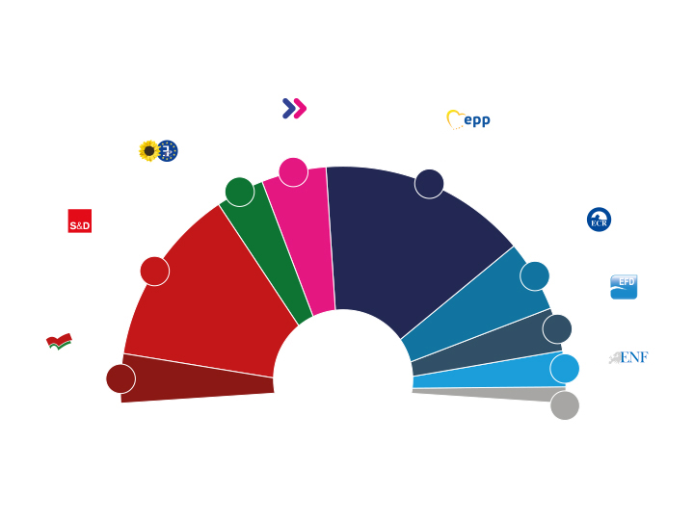
Political groups
Alliance of Liberals
and Democrats for Europe
Group of the European People’s Part
(Christian Democrats)
Group of the Greens
European Free Alliance
68
52
217
Group of the Progressive
Alliance of Socialists and
Democrats in the
European Parliament
European Conservatives and Reformists Group
186
75
Europe of Freedom
and Direct Democracy
Group
41
751
Confederal Group of the European United Left – Nordic Green Left
37
52
Europe of Nations
and Freedom Group
22
Non-attached
Members
As of March 1, 2019
Notes:
Political groups
The Members of the European Parliament sit in political groups – they are not organised by nationality, but by political affiliation. There are currently 8 political groups in the European Parliament – and over 200 political parties are represented.
25 Members are needed to form a political group, and at least one-quarter of the Member States must be represented within the group. Members may not belong to more than one political group.
Some Members do not belong to any political group and are known as non-attached Members.
Main difference to national parliaments: no official governing or opposition parties, hence a different and more dynamic way of creating ad-hoc, spontaneous majorities for any given issue.
Links
MEPs by Member State and political group
http://www.europarl.europa.eu/meps/en/crosstable.html
Oldest and youngest MEP by member state:
http://www.europarl.europa.eu/news/en/press-room/20170110BKG57612/mid-term-election-of-new-ep-president-14-vice-presidents-and-five-quaestors/7/oldest-and-youngest-meps-by-member-state

Slide 12
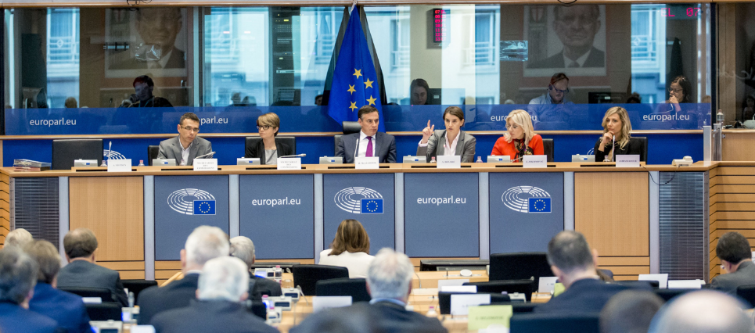
20 Parliamentary committees
Notes:
The Parliament’s committees
Committees are the legislative engines of the House.
Members are divided up among 20 specialised standing committees. These instruct legislative proposals through the adoption of reports, propose amendments to the Plenary and appoint a negotiation team to conduct negotiations with the Council on EU legislation.
A committee consists of between 25 and 73 full members and an equivalent number of substitutes.
Each committee elects a chair and up to four vice-chairs amongst its full members, for a two and a half year mandate. The political make-up of the committees reflects that of the plenary assembly.
Parliament can also set up sub-committees and special temporary committees to deal with specific issues, and is empowered to create committees of inquiry to investigate alleged contraventions or maladministration of EU law.
The parliamentary committees normally meet in Brussels, and their work is supported by a secretariat. Their debates are held in public and webstreamed.
Link:
List of standing committees and sub-committees, special committees and committees of inquiry:
http://www.europarl.europa.eu/committees/en/parliamentary-committees.html

Slide 13
Parliamentary committees
20 |  | MEPs |  | MEPs
 | AFET Foreign Affairs 2 sub-committees: Human Rights + Security and Defence | 73 | TRAN Transport and Tourism | 49
 | DEVE Development | 28 | REGI Regional Development | 43
 | INTA International Trade | 41 | AGRI Agriculture and Rural Development | 45
 | BUDG Budgets | 41 | PECH Fisheries | 25
 | CONT Budgetary Control | 30 | CULT Culture and Education | 31
 | ECON Economic and Monetary Affairs | 61 | JURI Legal Affairs | 25
 | EMPL Employment and Social Affairs | 55 | LIBE Civil Liberties, Justice and Home Affairs | 60
 | ENVI Environment, Public Health and Food Safety | 69 | AFCO Constitutional Affairs | 25
 | ITRE Industry, Research and Energy | 67 | FEMM Women’s Rights and Gender Equality | 35
 | IMCO Internal Market and Consumer Protection | 40 | PETI Petitions | 35

Slide 14
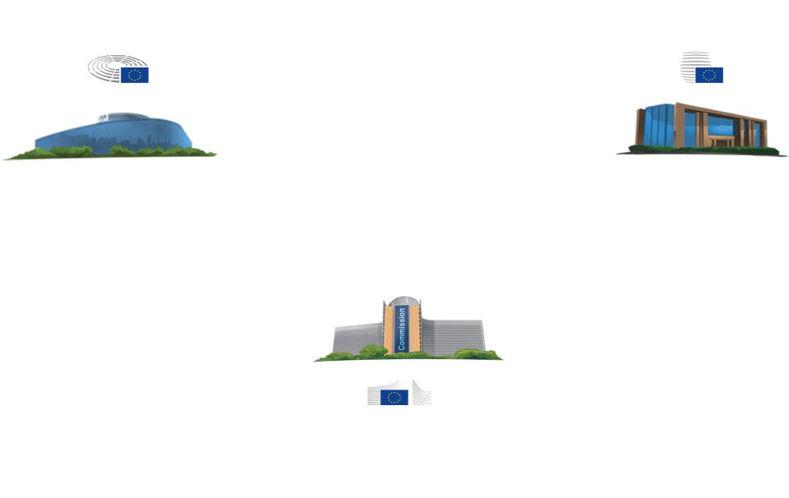
How EU laws are agreed
Co-legislators
Parliament
Council
Initiator
Commission
Notes:
How EU laws are agreed
The European Commission prepares legislative proposals on its own initiative or at the request of other EU institutions or countries, or following a citizens' initiative, often after public consultations.
The final proposal is forwarded simultaneously to the European Parliament, Council and national parliaments.
The President of the European Parliament refers the proposal to a parliamentary committee, which appoints a rapporteur who is responsible for drawing up a draft report containing amendments to the proposed text.
The committee votes on this report and any amendments to it tabled by other members.
The European Parliament then discusses and votes on the legislative proposal in plenary on the basis of the committee report and amendments. The result is the Parliament's position.
Parliament can accept the proposal without any changes or make amendments. In rare cases the President can request the Commission withdraw its proposal. Parliament's 1st reading position is forwarded to the Council.
Council can: accept the EP position, in which case the legislative act is adopted; or adopt changes to Parliament's position, leading to a Council's 1st reading position, which is sent to Parliament for a 2nd reading. And so on until agreement is reached or the procedure is ended.
Links
Legislative procedure
http://www.europarl.europa.eu/external/html/legislativeprocedure/default_en.htm
VIDEO OLP: https://www.europarltv.europa.eu/programme/eu-affairs/lawmaking-in-the-eu
Commission work programmes:
https://ec.europa.eu/info/publications/european-commission-work-programme_en
https://ec.europa.eu/info/sites/info/files/cwp_2019_explained_factsheet_en_1.pdf

Slide 15
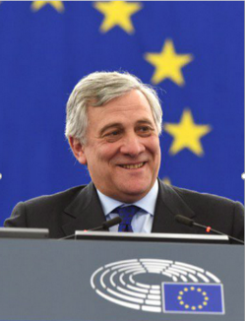
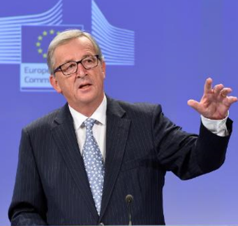
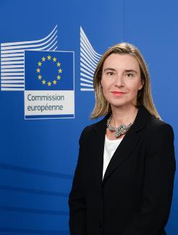
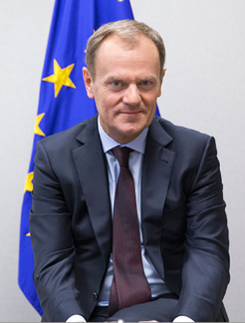
Key players
Jean-Claude Juncker
European Commission
Federica Mogherini
European External Action Service
Donald Tusk
European Council
Antonio Tajani
European Parliament
Notes:
Key players
The Parliament’s President is elected for a renewable term of two and a half years, i.e. half the lifetime of a Parliament. The President represents the European Parliament vis-à-vis the outside world and in its relations with the other EU institutions.
There is a President of the Parliament, a President of the Commission, and of the Council – as well as the High Representative of for Foreign Affairs and Security Policy.
Link:
EU presidents – who does what?
https://europa.eu/european-union/about-eu/presidents_en
ABC on EU institutions
http://www.europarl.europa.eu/news/en/headlines/eu-affairs/20130905STO18726/abc-of-the-eu-institutions
How the President of European Commission is elected?
http://www.europarl.europa.eu/news/en/headlines/eu-affairs/20140711STO52254/how-the-president-of-the-european-commission-gets-elected
EU institutional balance:
https://europa.eu/european-union/topics/institutional-affairs_en

Slide 16
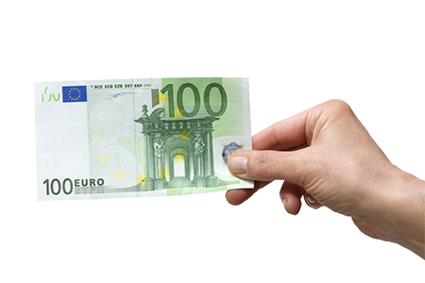
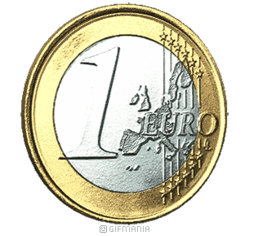
EU budget and 28 member states‘ budgets
Notes:
EU budget versus member states budget
The EU budgets is only 1% of the total value of the EU economy (Gross National Income of all EU Member States).
Link:
Myth and facts
http://ec.europa.eu/budget/explained/myths/myths_en.cfm

Slide 17
Notes:
EU budget - where does the money go
About 94% of the budget funds real activities on the ground in EU countries and beyond. The EU budget finances activities ranging from developing rural areas and conserving the environment to protecting external borders and promoting human rights. The Commission, the Council and Parliament all have a say in determining the size of the budget and how it is allocated.
Currently the largest share goes on creating growth and jobs and reducing economic gaps between the EU's various regions. Agriculture, rural development, fisheries and environmental protection also account for a major share. Other areas of expenditure include combating terrorism, organised crime and illegal immigration.
6% are the running costs/administrative costs of all three institutions - How much does your national administration cost?
Main difference to a national budget: it is an investment budget (European added value) and cannot run deficits.
Why an EU budget? It is based on the idea that sometimes and in some areas (agreed upon unanimously by EU member states in the form of the EU treaties) a euro spent by the EU is worth more for the common European good than a euro spent nationally
Links
Interactive infographic „EU budget explained“ - expenditure and contribution per country per country
http://www.europarl.europa.eu/news/en/headlines/economy/20180316STO99923/the-eu-budget-expenditure-and-contribution-by-member-state
EU Budget in my country
http://ec.europa.eu/budget/mycountry/index_en.cfm
Myths and facts about EU budgets
http://ec.europa.eu/budget/explained/myths/myths_en.cfm
2018 budget:
http://ec.europa.eu/budget/library/biblio/publications/2017/EUbudget-factsheet-2018_en.pdf

Slide 18
EU budget - where does the money come from
Notes:
EU budget – where does money come from
The EU budget is funded from three main sources: Member State contributions, based on a percentage of their Gross National Income. Import duties on goods entering from outside the EU. A percentage of each Member State's national VAT rate.
Links
EU revenues:
http://ec.europa.eu/budget/figures/2007-2013/index_en.cfm

Slide 19
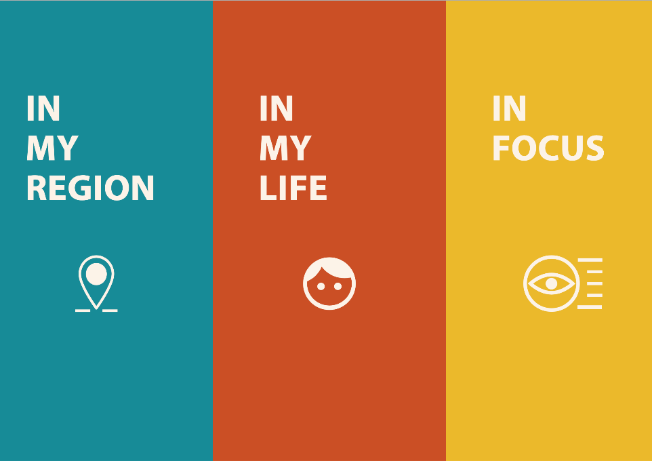
What Europe does for you
Notes:
What Europe does for you
How does Europe affect our everyday lives? How does it impact our jobs, our families, our health care, our hobbies, our journeys, our security, our consumer choices and our social rights? And how is Europe present in our towns, cities and regions?
As European citizens, no matter where we live or how we make our living or spend our time, the EU has an impact on our daily lives. Ahead of the 2019 European elections, this website presents a series of short notes exploring EU deliveries and actions from the individual’s point of view. In a one-page format, these notes are available for you to read, share or reuse. And if you want to dig deeper, have a look at our longer briefing papers on EU policies in focus.
This is a living website and we will add more material in more EU languages over the coming months. So, let’s check out what Europe does for you:
Link:
What Europe does for me
https://what-europe-does-for-me.eu/

Slide 20
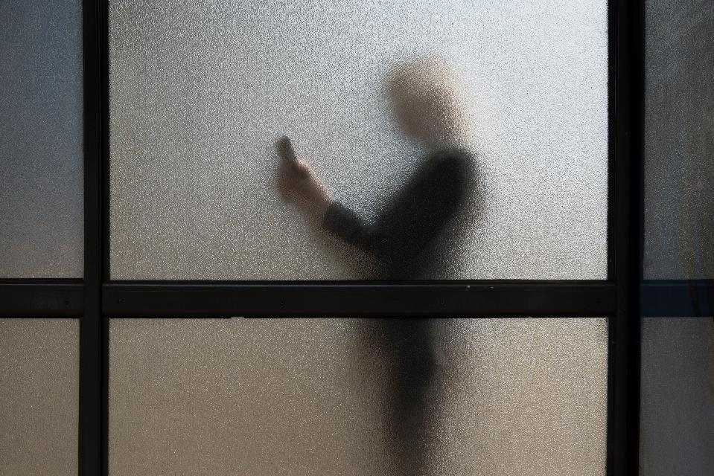
Notes:
Privacy
Online privacy - right to be forgotten
http://www.europarl.europa.eu/RegData/bibliotheque/briefing/2012/120280/LDM_BRI(2012)120280_REV1_EN.pdf
Better protection for children online
https://multimedia.europarl.europa.eu/en/better-protection-for-children-online_N01-PUB-170425-PROT_ev
Data protection regulation
https://multimedia.europarl.europa.eu/en/infoclip-data-protection-regulation_I155751-V_v
Internet users whose personal data is collected online
https://what-europe-does-for-me.eu/en/portal/2/N08
Smartphone and tablet users
https://what-europe-does-for-me.eu/en/portal/2/N03

Slide 21

Notes:
Knowledge
Trainees
https://what-europe-does-for-me.eu/en/portal/2/M10
Erasmus – students learning abroad
https://what-europe-does-for-me.eu/en/portal/2/M05
New Erasmus+ budget to boost mobility and opportunities for youth
https://multimedia.europarl.europa.eu/en/new-erasmus-budget-to-boost-mobility-and-opportunities-for-youth_N01-PUB-190225-ERAS_ev

Slide 22
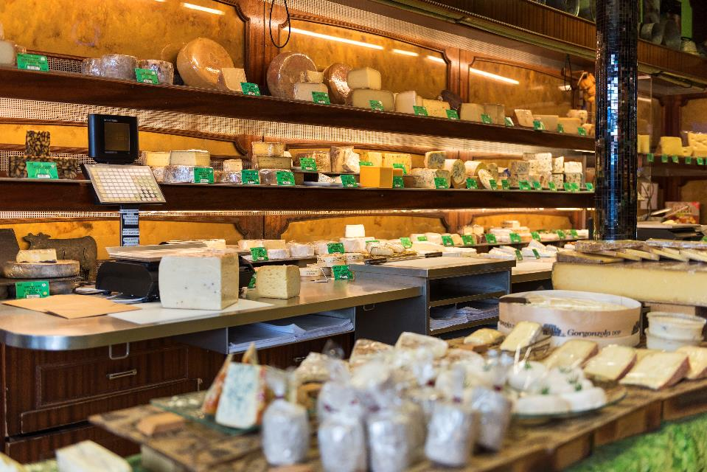
Notes:
Choice
Consumer protection
https://what-europe-does-for-me.eu/en/portal/2/G08
http://www.europarl.europa.eu/RegData/etudes/BRIE/2019/633141/EPRS_BRI(2019)633141_EN.pdf
https://multimedia.europarl.europa.eu/en/consumer-protection_B01-ESN-180427_ev
Farmers
https://what-europe-does-for-me.eu/en/portal/2/B04
Dairy farmers
https://what-europe-does-for-me.eu/en/portal/2/B50
Consumers of regional and traditional products
https://what-europe-does-for-me.eu/en/portal/2/E20
Consumers of chocolate
https://what-europe-does-for-me.eu/en/portal/2/E14
Geo-blocking and online shopping
https://multimedia.europarl.europa.eu/en/geo-blocking-and-online-shopping_N01-PUB-181203-GEOB_ev

Slide 23
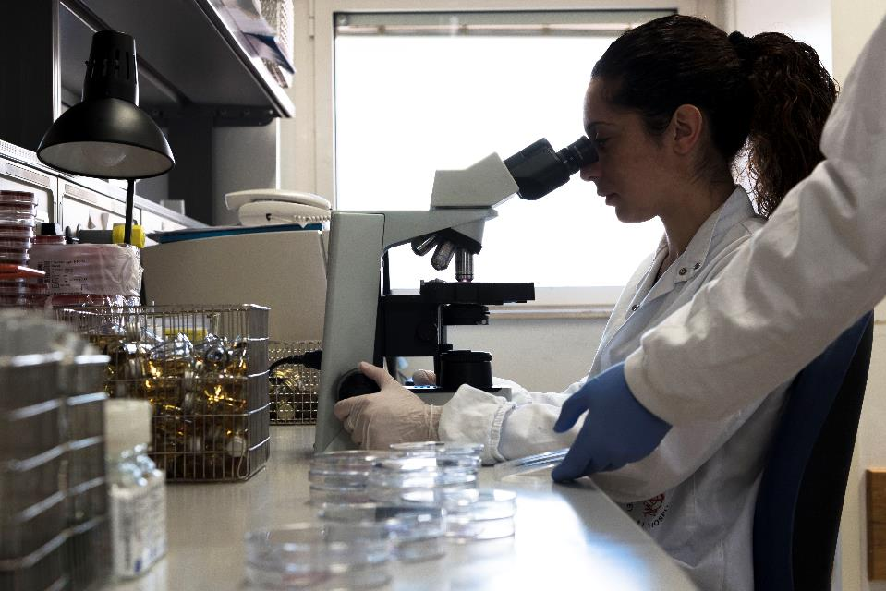
Notes:
Sciences
Researchers
https://what-europe-does-for-me.eu/en/portal/2/B01
Academics
https://what-europe-does-for-me.eu/en/portal/2/B03

Slide 24
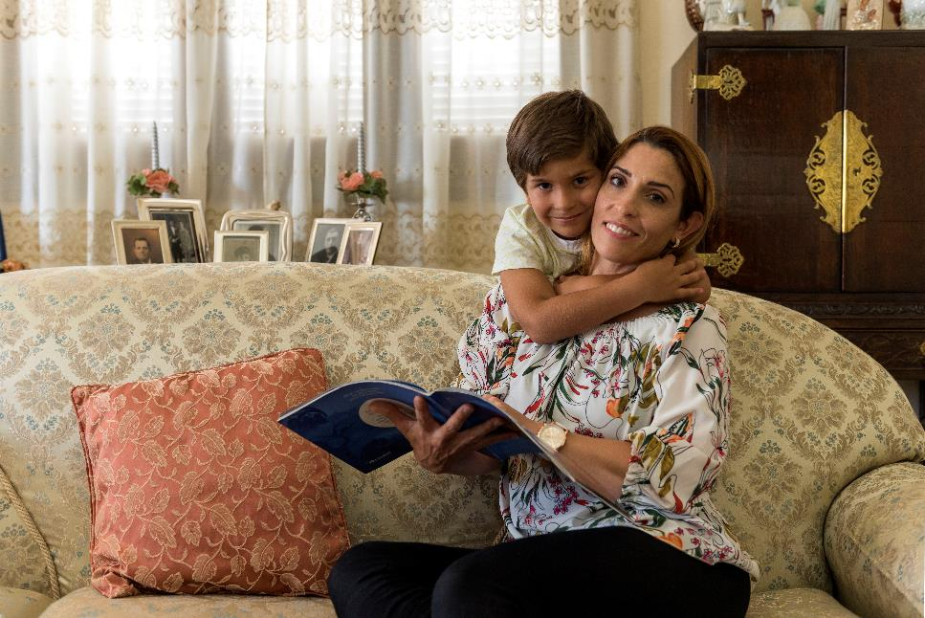
Notes:
Social protection, children rights
Parents and parents to be
https://what-europe-does-for-me.eu/en/portal/2/G09
Social protection – parental leave
https://multimedia.europarl.europa.eu/en/social-protection-parental-leave_I164862-V_v
Single parents
https://what-europe-does-for-me.eu/en/portal/2/A02
Child victims of violence
https://what-europe-does-for-me.eu/en/portal/2/P07
Children going online
https://what-europe-does-for-me.eu/en/portal/2/N05

Slide 25
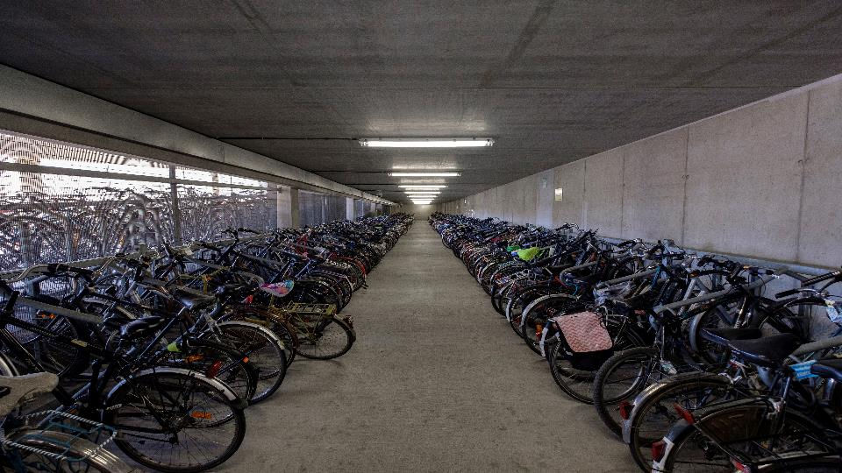
Notes:
Clean air
People living in cities with polluted air
https://what-europe-does-for-me.eu/en/portal/2/C13
Environmentalists at local level
https://what-europe-does-for-me.eu/en/portal/2/L09
Stricter emission caps to curb air pollution
https://multimedia.europarl.europa.eu/en/stricter-emission-caps-to-curb-air-pollution_N001-161122-001_ev
Every breath you take
https://multimedia.europarl.europa.eu/en/every-breath-you-take_M006-0017-001_ev

Slide 26
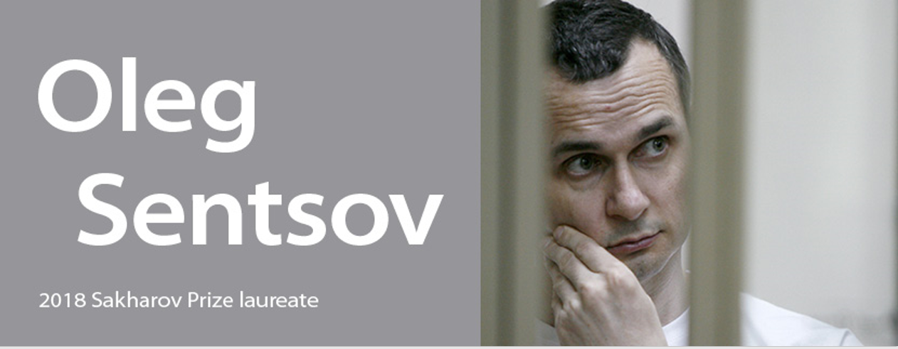
Human rights Sakharov Prize from 1988
Andrej
Sakharov
Notes:
Sakharov prize for freedom of thought
Respect for human rights is one of the European Union's fundamental values. The European Parliament fights such violations through legislative action, including election observation, monthly human rights debates in Strasbourg and by enshrining human rights in its external trade agreements.
The European Parliament also supports human rights through the annual Sakharov Prize for Freedom of Thought, established in 1988. The prize is awarded to individuals who have made an exceptional contribution to the fight for human rights across the globe, drawing attention to human rights violations as well as supporting the laureates and their cause.
Links
2018 laureate
http://www.europarl.europa.eu/news/en/headlines/eu-affairs/20181018STO16585/sakharov-prize-2018-goes-to-oleg-sentsov
Laureates of the Sakharov prize
http://www.europarl.europa.eu/sakharovprize/en/laureates.html
How the laureate is chosen:
http://www.epgencms.europarl.europa.eu/cmsdata/upload/2aedebc0-cf0f-4e87-b91f-0b0ae23b7803/SAK_prize_infographic_vertical_EN.pdf

Slide 27
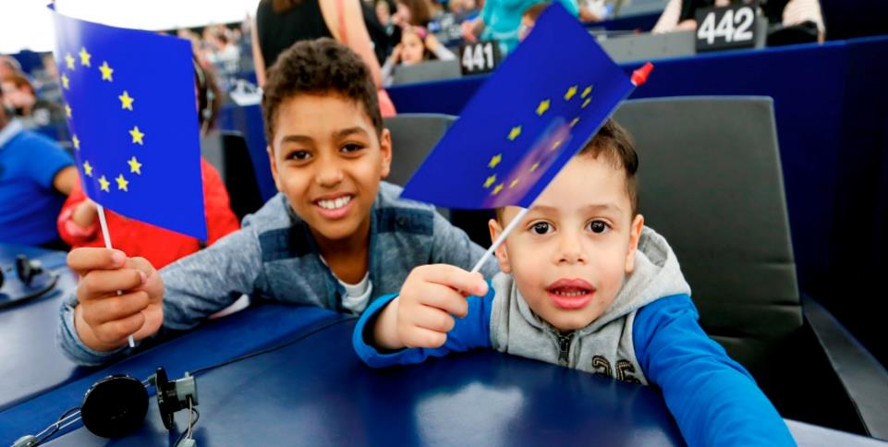

Stay in touch!
europarl.eu
Notes:
Stay in touch
European Parliament in social media networks
From Pinterest to LinkedIn, the European Parliament is present on most major social media platforms in order to better communicate with you. On these platforms we offer not only background information and the latest news, but also videos, photos, infographics and the opportunity to discuss topical issues. We also offer EP Newshub: our special tool to follow Parliament politics in real time. Try out our interactive infographic to get a taster of what we serve up on each platform.
Link
The social networks at a glance
http://www.europarl.europa.eu/external/html/socialmediaataglance/default_en.html

